Slide 1
BITS Pilani presentation
Dr. Yashvardhan Sharma
Computer Science and Information Systems

Slide 2
SS ZG514/SE Z512
Object Oriented Analysis and Design
Lecture No.7

Slide 3
Today’s Agenda
System Contracts
Object Design
Interaction Diagrams
Sequence Diagrams
Collaboration Diagrams

Slide 4
Operation Contracts

Slide 5
System Sequence diagram [1]
Use cases suggest how actors interact with the software system
An actor generates events to a system, requesting some operation in response
Example - when a cashier enters an item’s UPC, the cashier requests the POST system to record that item purchase. That request event initiates an operation upon the system
Desirable to isolate and illustrate the operations that an actor requests to a system

Slide 6
System Sequence Diagram [2]
SSD Shows for a particular scenario of a use case, the events that external actors generate, their order and inter-system events
A scenario of a use case is a particular instance or realized path
Should be done for a typical course of events of the use case (usually for the most interesting ones)

Slide 7
System Events, Operations
System event - external input event generated by an actor
System operation - operation of the system that executes in response

Slide 8
Recording System operations
Set of all required systems operations is determined by identifying the system events.
Examples: enterItem(UPC,quantity);
endSale();
makePayment(amount)
UML notation -
Operation(arg:ArgType=defaultvalue,,,):ReturnType(s)

Slide 9
Objectives
Create contracts for system operations.

Slide 10
Why Contracts
Use cases are the primary mechanism in the UP to describe system behavior, and are usually sufficient.
However, sometimes a more detailed description of system behavior has value.
Contracts for operations can help define system behavior.
Describes what happens without explaining how.

Slide 11
Definition
Contracts describe detailed system behavior in terms of state changes to objects in the Domain Model, after a system operation has executed.

Slide 12
System Operations and the System Interface
Contracts may be defined for system operations – operations that the system as a black box offers in its public interface to handle incoming system events. System operations can be identified by discovering these system events.
The entire set of system operations, across all use cases, defines the public system interface, viewing the system as a single component or class.

Slide 13
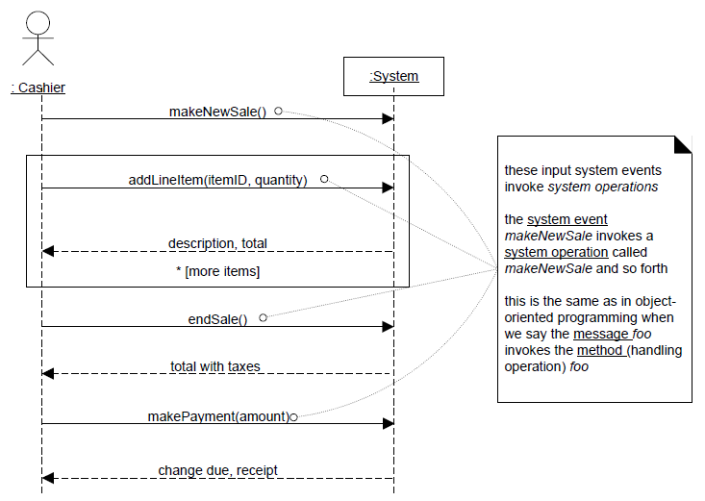
System operations handle input system events

Slide 14
System Contracts
Define responsibilities within the system.
Operational contracts take the form of preconditions and post-conditions
– Each module tests pre-conditions, then runs, then tests post-conditions before returning to the caller

Slide 15
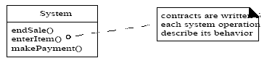
System Contracts
Operational contracts state what an operation commits to achieving.
Emphasizes what will happen, not how
Describes changes in the state of the system – Semantics

Slide 16
Contract Sections
Operation: Name Of operation, and parameters.
Cross References: (optional) Use cases this can occur within.
Preconditions: Noteworthy assumptions about the state of the system or objects in the Domain Model before execution of the operation.
Postconditions: -The state of objects in the Domain Model after completion of the operation.

Slide 17
Example Contract: enterItem
Contract CO2: enterItem
Operation: enterItem(itemID : ItemID, quantity : integer)
Cross References: Use Cases: Process Sale
Preconditions: There is a Sale Underway.
Postconditions: -A SalesLineItem instance sli was created (instance creation) -sli was associated with the current Sale (association formed) -sli.quantity became quantity (attribute modification) -sli was associated with a ProductSpecification, based on itemID match (association formed)

Slide 18
Postconditions
The postconditions describe changes in the state of objects in the Domain Model. Domain Model state changes include instances created, associations formed or broken, and attributes changed.
Postconditions are not actions to be performed during the operation; rather, they are declarations about the Domain Model objects that are true when the operation has finished.
postconditions support fine-grained detail and specificity in declaring what the outcome of the operation must be.

Slide 19
How to Make a Contract
Identify operations from the system sequence diagram
For each system operation, construct a contract
For system operations that are complex and perhaps subtle in their own results, or which are not clear in the use case, construct a contract.
The post-conditions describe changes in the state of objects in the Domain Model.
To describe post-conditions, use the following categories:
– Instance creation and deletion
– Attribute modification
– Associations formed and broken

Slide 20
enterltem Postconditions
Instance Creation and Deletion:
After the itemID and quantity of an item have been entered, what new object should have been created? A SalesLineltem. Thus:
A SalesLineltem instance sli was created (instance creation).
Note the naming of the instance. This name will simplify references to the new instance in other post-condition statements.

Slide 21
enterltem Postconditions
Attribute Modification:
After the itemID and quantity of an item have been entered by the cashier, what attributes of new or existing objects should have been modified? The quantity of the SalesLineltem should have become equal to the quantity parameter. Thus:
sli.quantity became quantity (attribute modification).

Slide 22
enterltem Postconditions
Associations Formed and Broken:
After the itemID and quantity of an item have been entered by the cashier, what associations between new or existing objects should have been formed or broken? The new SalesLineltem should have been related to its Sale, and related to its ProductSpeciflcation. Thus:
. sli was associated with the current Sale (association formed).
. sli was associated with a ProductSpeciflcation, based on ItemID match (association formed).

Slide 23
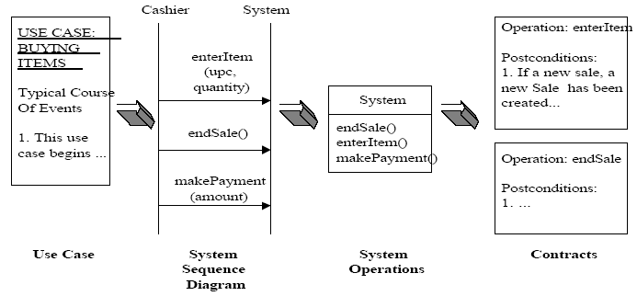
POST Contract Process

Slide 24
Writing Contracts Leads to Domain Model Updates
New conceptual classes, attributes, or associations in the Domain Model are often discovered during contract writing.
Enhance the Domain Model as you make new discoveries while thinking through the operation contracts.

Slide 25
Contracts vs. Use Cases
The use cases are the main repository of requirements for the project. They may provide most or all of the detail necessary to know what to do in the design.
If the details and complexity of required state changes are awkward to capture in use cases, then write operation contracts.
If, just based on the use cases and through ongoing collaboration with a subject matter expert, the developers can comfortably understand what to do, then avoid writing contracts.

Slide 26
Advice on Writing Contracts
To make contracts:
1. Identify system operations from the SSDs.
2. For system operations that are complex and perhaps subtle in their results, or which are not clear in the use case, construct a contract.
3. To describe the postconditions, use the following categories:
instance creation and deletion
attribute modification
associations formed and broken

Slide 27
Advice on Writing Contracts
Fill in the Operation section first
– Post-conditions section next
– Pre-conditions section last!
Express post-conditions in the past tense, to emphasize they are declarations about a state change in the past.
(better) A SalesLineItem was created.
(worse) Create a SalesLineItem.

Slide 28
Advice on Writing Contracts
Establish a memory between existing objects or those newly created by defining the forming of an association. For example, it is not enough that a new SalesLineltem instance is created when the enterltem operation occurs. After the operation is complete, it should also be true that the newly created instance was associated with Sale. Don’t forget to include all the associations formed and broken.

Slide 29
Example Contract
makeNewSale:
Operation: makenewsale()
Cross Reference: Use Cases: Process Sale
Pre-condition: None
Post-condition: - A Sale instance s was created (instance creation).
- s was associated with the Register (association formed).
- Attributes of s were initialized.
On a project, all these particular postconditions are so obvious from the use case that the makeNewSale contract should probably not be written.

Slide 30
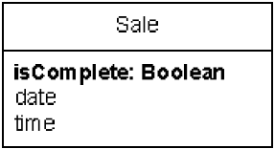
Example Contract
endSale:
Operation: endsale()
Cross Reference: Use Cases: Process Sale
Pre-condition: There is a sale underway
Post-condition: - Sale.isComplete became true (attribute modification).
Changes in Domain Model:

Slide 31
Example Contract
makePayment:
Operation: makePayment( amount: Money)
Cross Reference: Use Cases: Process Sale
Pre-condition: There is a sale underway
Post-condition: - A Payment instance p was created (instance creation).
- p.amountTendered became amount (attribute modification).
- p was associated with the current Sale (association formed).
- The current Sale was associated with the Store (association formed); (to add it to the historical log of completed sales)

Slide 32
Summary : Contracts
A contract describes detailed system behavior in terms of state changes to objects in the domain model.
A contract is a system operation. It is offered in the system’s public interface.
One use case may require one or more system operations (events) to complete a scenario.
Most contracts will be written during elaboration phase, when most use cases are written. Only write contracts for the most difficult to understand or complicated system operations.

Slide 33
Artifacts of Analysis

Slide 34
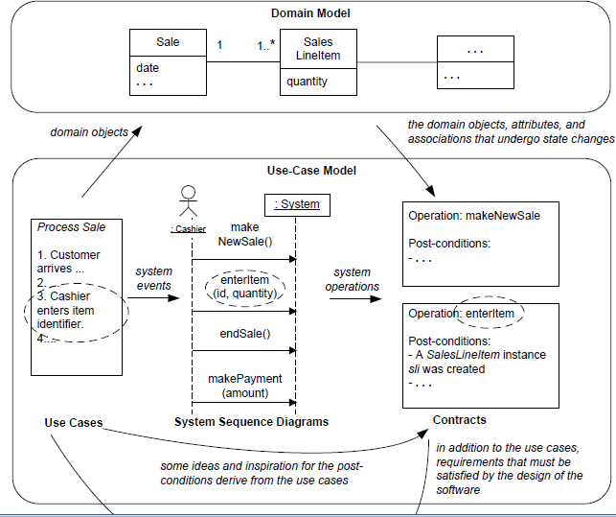
Contract relationship to other artifacts

Slide 35
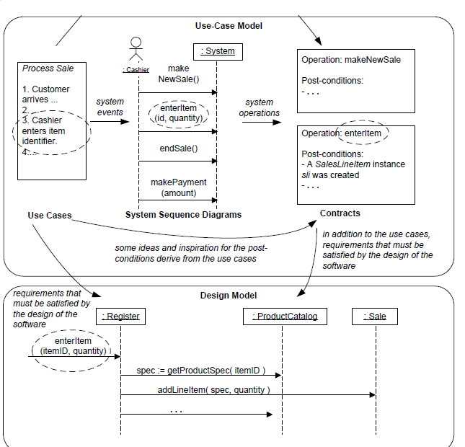
Contract relationship to other artifacts(1)

Slide 36
REQUIREMENTS DESIGN
Till now we have covered requirements analysis.
The requirements and object-oriented analysis has focused on learning to do the right thing. that is, understanding some of the outstanding goals for the Next-Gen POS, and related rules and constraints.
Now onwards we will start designing:
Design work will stress do the thing right; that is, skillfully designing a solution to satisfy the requirements for this iteration.

Slide 37
REQUIREMENTS DESIGN
In iterative development, a transition from primarily a requirements focus to primarily a design and implementation focus will occur in each iteration.
It is natural and healthy to discover and change some requirements during the design and implementation work of the early iterations.
During object design, a logical solution based on the object-oriented paradigm is developed. The heart of this solution is the creation of interaction diagrams, which illustrate how objects collaborate to fulfill the requirements. We can start designing class diagram after or in parallel with interaction diagram.

Slide 38
Object Design

Slide 39
Learning Objectives
To learn notations for representing a design.
To understand and be able to apply the basic principles of software design.
To learn techniques and tools for Object- Oriented Design.
Interaction diagrams
Class diagrams
State diagrams

Slide 40
Objectives
To explain how a software design may be represented as a set of interacting objects that manage their own state and operations
■
To introduce various models that describe an
object-oriented design
■
To introduce design patterns

Slide 41
Models during the Design Phase
Object behavior model
Class model
Static structure
diagrams
Interaction Diagrams: Collaboration diagrams
Sequence diagrams
Design state model
Contracts for
methods and operations
State diagrams
for classes

Slide 42
Object-oriented Analysis and Design
Object-oriented analysis
What are the domain objects?
Described in a domain object model
Object-oriented design
Describing the software solution in terms of collaborating objects, with responsibilities.

Slide 43
What is Object-Oriented Analysis and Design
OOA: we find and describe objects or concepts in the problem domain
OOD: we define how these software objects collaborate to meet the requirements.
Attributes and methods.
OOP: Implementation: we implement the design objects in, say, Java, C++, C#, etc.

Slide 44
Thinking in Terms of Objects and UML
Object-Oriented Design
Emphasizes a conceptual solution that fulfills the requirements.
Need to define software objects and how they collaborate to fulfill the requirements.
For example, in the Library Information System, a Book software object may have a title attribute and a getChapter method.
Designs are implemented in a programming language.
In the example, we will have a Book class in Java.

Slide 45
The Object
OBJECT
Object Identity
Attributes
contained in data
structures
Object State
Procedures which
can operate on the
data structures
Object behaviour
Notes:
Based on notes from Brian Stone

Slide 46
Object communication
Conceptually, objects communicate by message passing.
Messages
The name of the service requested by the calling object.
Copies of the information required to execute the service and the name of a holder for the result of the service.
In practice, messages are often implemented by procedure calls
Name = procedure name.
Information = parameter list.

Slide 47
Message examples
// Call a method associated with a buffer // object that returns the next value // in the buffer
v = circularBuffer.Get () ;
// Call the method associated with a // thermostat object that sets the // temperature to be maintained
thermostat.setTemp (20) ;

Slide 48
Interacting objects

Slide 49
Interactions - Basics
Interaction — behavior that comprises a set of messages exchanged among a set of objects within a context to accomplish a purpose.
Realizes use cases
Static representation of objects working to complete some action.
Introduce messages between objects and classes.
Invocation of an operation.
Construction, or destruction, of an object.
Models flow of control within an operation.
Identify how messages are dispatched across time.
Focus on the structural relationships among objects involved in an interaction.
Properties of well-structured interactions
Efficient, Simple, Adaptable, Understandable

Slide 50
Interactions – Concrete vs. Prototypical Objects
Objects within an interaction can be:
Concrete — something from the real world.
Prototypical — representative instance of something from the real world.
Collaborations use strictly prototypical things.
Prototypical instances of interfaces and abstract types are valid.
Can be identified from class diagrams.

Slide 51
Interaction Diagrams
Interaction Diagrams are models that describe how groups of objects collaborate in some behavior.
Interaction Diagrams provide a thoughtful, cohesive, common starting point for inspiration during programming
Patterns, principles, and idioms can be applied to improve the quality of the Interaction Diagrams

Slide 52
On to Object Design
During object design, a logical solution based on the object-oriented paradigm is developed. The heart of this solution is the creation of interaction diagrams which illustrates how objects collaborate to fulfill the requirements.
After or in parallel with drawing interaction diagrams, class diagrams can be drawn.

Slide 53
Introduction
Why do objects exist?
To perform an activity to help fulfill a system’s purpose
Interaction Diagrams are used to model system dynamics
How do objects change state?
How do objects interact (message passing)?

Slide 54
Collaboration & Sequence Diagrams
An Interaction Diagram is a generalization of two specialized UML diagram types
Collaboration Diagrams: Illustrate object interactions organized around the objects and their links to each other
Sequence Diagrams: Illustrate object interactions arranged in time sequence

Slide 55
Collaboration & Sequence Diagrams (2)
Both diagram types are semantically equivalent, however, they may not show the same information
Collaboration Diagrams emphasize the structural organization of objects, while Sequence Diagrams emphasize the time ordering of messages
Collaboration Diagrams explicitly show object linkages, while links are implied in Sequence Diagrams

Slide 56
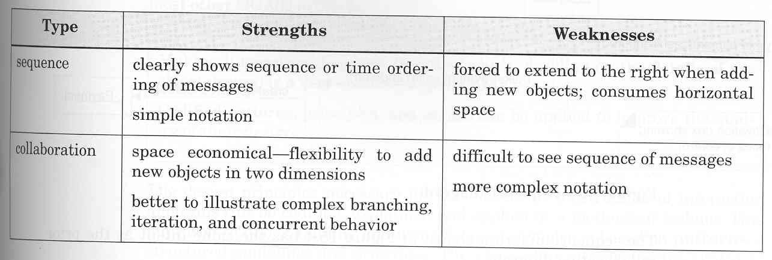
Sequence vs. Collaboration Diagrams

Slide 57
A collaboration diagram
1: message2()
2: message3()
message1()
:classAinstance
:classBinstance
message1() is sent to an instance of class A.
message2() and message3() are sent, in that
order, by an instance of class A to an instance of
class B.
One diagram for each system event.

Slide 58
A sequence diagram
:classAinstance
:classBinstance
message1()
message2()
message3()
Focus of control,
activation box, optional
May be used for multiple events.

Slide 59
Collaboration diagram: makepayment()
direction of message
first internal message
makePayment(cashTendered)
1: makePayment(cashTendered)
:POST
:Sale
first message
1.1: create(cashTendered)
link line
instance of a class
:Payment
parameter

Slide 60
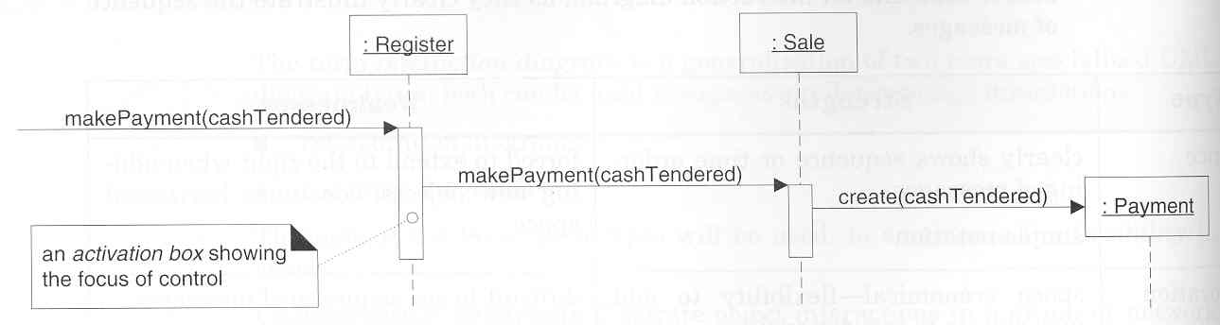
Example SD: makePayment
[Larman, 2002]

Slide 61
Interaction Diagrams
Interaction diagrams
model the dynamic aspects of a system.
show the interaction of any kind of instance in any view of a system’s
architecture (classes, interfaces, components, and nodes).
model the system as a whole.
are attached to use cases to model a scenario.
Sequence diagram
Emphasizes time ordering of messages.
Depicts the lifeline of objects.
Collaboration diagram
Emphasizes structural organization.
Potentially easier to model complex interactions.

Slide 62
Modeling Flow of Control
Set the context for the interaction.
Set the stage by identifying participating objects.
Use in two (2) ways:
1. Model flows of control by time ordering:
Specify the messages that pass from object to object in time order.
2. Model flows of control by organization:
If emphasizing the structural organization, identify related links.

Slide 63
Flow of Control by Time vs. by Organization
Flow of Control by Time -> Sequence Diagram
p : StockQuotePublisher
s1 : StockQuoteSubscriber
s2 : StockQuoteSubscriber
attach(s1)
attach(s2)
notify()
update()
getState()
update()
getState()
Flow of Control by Organization -> Collaboration Diagram
4 : update()
s1 : StockQuoteSubscriber
3 : notify()
1 : attach(s1)
6 : getState()
p : StockQuotePublisher
5 : update()
2 : attach(s2)
7 : getState()
s2 : StockQuoteSubscriber

Slide 64
Interactions - Links
Semantic connection among objects.
An instance of an association or dependency.
Provide a passage for messages.
Class Diagram
Person
1..*
*
Company
employee
employer
+ setCompensation( s : Salary )
+ assign( d : Department )
…
anonymous object
Object Diagram
message
assign( development )
p : Person
: Company
link
named object

Slide 65
Interactions - Messages
Message — specification of a communication between objects that conveys information with the expectation that activity will ensue.
Directed line near link.
Name of operation must be defined on target.
message
sequence number
1.1 : getLastCheckpoint( )
1 : getPositionAtTime( t )
t : AirTrafficPlanner
p : FlightPlan
link
object

Slide 66
Interactions - Modeling Actions
Call* — invokes an operation on an object.
Return — returns a value to the caller.
Send* — sends a signal to an object.
Create — creates an object.
Destroy — destroys an object.
*Essentially the same, but send implies an event notification or control flow between objects
object
c : Client
p : PlanningAgent
create
<<create>>
: TicketAgent
actual parameter
setItenerary( i )
calculateRoute()
return
route
return value
call on self
destroy
<<destroy>>
X
notify()
send

Slide 67
Interactions - Sequencing
A stream of messages where actions are delegated forms a sequence.
The beginning of each sequence is rooted in some process or thread.
Each thread defines a distinct flow of control.
Messages are ordered in sequence by time.
Represented by a sequence number followed by a colon.

Slide 68
Interactions - Procedural Sequencing vs. Flat Sequencing
Procedural Sequencing
Most common.
Each message within the same operation is numbered sequentially.
Nested messages are prefixed with the sequence number of the invoking operation.
Rendered with filled solid arrow.
Flat Sequencing
Infrequent Not recommended for most situations.
Each message is numbered sequentially in order of timing.
Shows progression of control.
Rendered with stick arrowhead.

Slide 69
Interactions - Procedural Sequencing vs. Flat Sequencing
Procedural Sequencing
Flat Sequencing
message
sequence number
2 : clickAt( p )
:View
2 : clickAt( p )
c : Controller
2.2 : putRecentPick( l )
:Cache
2.1 : l = findAt( p )
nested of control
message
sequence number
sequence number
1 : liftHandset()
2 : assertCall()
c : Caller
:Telephone
:Exchange
flat flow of control

Slide 70
Interactions - Thread Identification, Creation & Destruction
Message sequence number prefixed with thread identifier.
E.g., Th2 : openDoor (3)
the operation openDoor is dispatched, with the actual argument 3, as the 2nd message in the sequence rooted by the process or thread named Th.
Helps distinguish multiple threads of control.
Consider coloring messages to match threads.
Adorn with constraints.
new
destroyed
transient
1 : <<create>>
2.3 : update( p )
4 : <<destroy>>
c : Controller
{transient}

Slide 71
Making collaboration diagrams
One diagram for each system operation in the current development cycle, e.g. for makepayment().
If the diagram gets complex, split into smaller diagrams.
Design a system of interacting objects to fulfill the tasks....this is the tough part of design!

Slide 72
Classes and Objects
Sale
:Sale
s1:Sale
class
object or instance
named object

Slide 73
Links
msg1()
addPayment(cashTendered)
:Post
:Sale
link line
Link - connection path between two objects (an instance of an association)

Slide 74
Messages
msg1()
1: message1()
2: message2()
3: message3()
:Post
:Sale
3.1: message4()
all messages flow on the same link

Slide 75
Parameters
msg1()
1: addPayment(amount:Money)
:Post
:Sale
parameters shown within parentheses;
types may also be shown

Slide 76
Return values
return value type
msg1()
1: tot:=total(): int
:Post
:Sale
return value name

Slide 77
Messages to “self” or “this”
msg1()
:Post
1: clear()

Slide 78
Iteration
Iteration (Looping)
Seq. Number * [ i := 1..N ]: message()
“*” is required; [ ... ] clause is optional
msg1()
1*: li = nextLineItem(): SalesLineItem
:Post
:Sale
iteration, no recurrence values

Slide 79
Iteration with recurrence
msg1()
1*: [i:= 1..10] li = nextLineItem(): SalesLineItem
:Post
:Sale
iteration clause

Slide 80
Iteration clause: Multiple messages
msg1()
{
for i:= 1 to 10
{
myB.msg2();
myC.meg3();
}
}
equal iteration clauses
msg1()
1* [i:= 1..10]: msg2()
:A
:myB: B
2* [i:= 1..10]: msg3()
:myC: C

Slide 81
Languages and create
C++
Automatic allocation, or new() operator followed by constructor call.
Java
new() operator followed by a constructor call.

Slide 82
Message sequence numbering
first message not numbered
second
third (nested)
msg1()
1: msg2()
:classA
:classB
1.1: msg3()
2.1: msg5()
2: msg4()
:classC
fifth (nested)
fourth

Slide 83
Conditional message
Conditional Message
Seq. Number [ variable = value ] : message()
Message is sent only if clause evaluates to true
msg1()
1*: [new sale] create()
:Post
:Sale
1.1: create()
conditional message with test
:SalesLineItem

Slide 84
Mutually exclusive conditional messages
Unconditional after
either msg2 or msg4
:ClassE
1a and 1b are mutually
exclusive
2: msg6()
msg1()
1a: [test_1] msg2()
:ClassA
:ClassB
1b: [not test_1] msg4()
1a.1: msg3()
1b.1: msg5()
:ClassD
:ClassC

Slide 85
Collections
sales:Sale
A multiobject or a collection of instances,
e.g. a List of Sales.

Slide 86
Messages to Multiobjects
Message sent to a
Multiobject.
msg1()
1*: s:=size(): int
:Sale
:SalesLineItem
*
Could be a Java list.
The two *’s imply iteration over all elements.

Slide 87
Messages to multiobjects and an element [1]
Message sent to an
element.
msg1()
1: el:=create()
:Sale
sl:SalesLineItem
2: addElement(el)
:SalesLineItem
Message sent to a
collection.

Slide 88
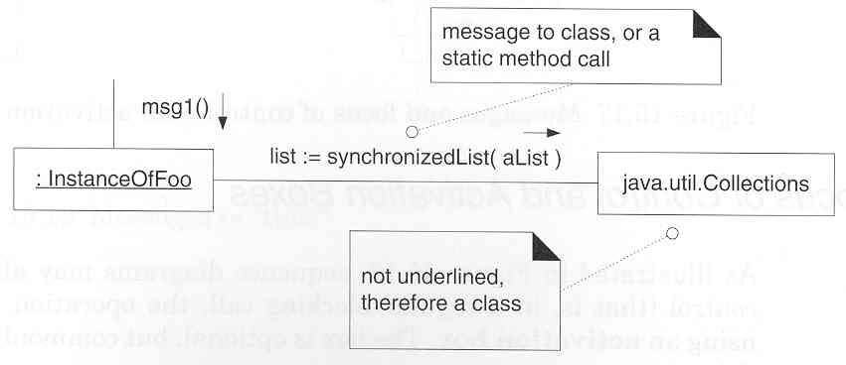
CDs: Messages to a Class
[Larman, 2002]

Slide 89
Design Guidelines
OO system consists of interacting objects.
How does one determine the assignment of responsibilities to various objects?
There is no unique assignment and hence “good” and “poor” designs, “beautiful” and “ugly” designs, “efficient” and “inefficient” designs.
Design guidelines assist in the derivation of a good design.

Slide 90
Sequence Diagrams
Correspond to one scenario within a Use Case
Model a single operation within a System over time
Identify the objects involved with each scenario
Identify the passed messages and actions that occur during a scenario
Identify the required response of each action

Slide 91
Notes: Collaboration Diagrams
It is legal to use a collaboration diagram for each system event message.
Each message between objects is represented with a message expression and small arrow indicating the direction. Many messages may flow along this link. A sequence number may be added to show the sequential order of messages, for example: 1:msg2()
The order and nesting of subsequent messages is shown with a legal numbering scheme. Nesting is denoted by pre-pending the incoming message number to the outgoing message number. For example: Message 1. and the nested message 1.1

Slide 92
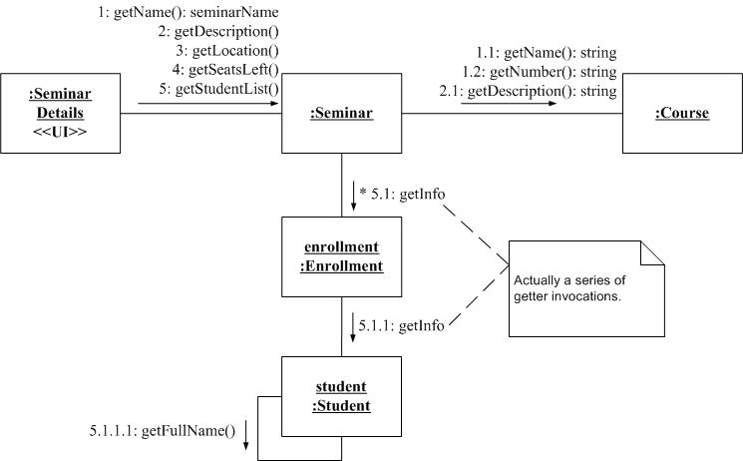
Communication Diagram

Slide 93
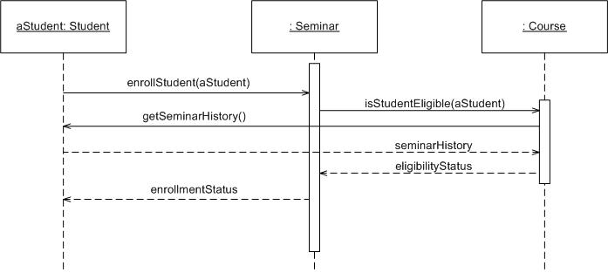
Sequence Diagram

Slide 94
Sequence diagram exercise: Poker use case, Start New Game Round
The scenario begins when the player chooses to start a new round in the UI. The UI asks whether any new players want to join the round; if so, the new players are added using the UI.
All players' hands are emptied into the deck, which is then shuffled. The player left of the dealer supplies an ante bet of the proper amount. Next each player is dealt a hand of two cards from the deck in a round-robin fashion; one card to each player, then the second card.
If the player left of the dealer doesn't have enough money to ante, he/she is removed from the game, and the next player supplies the ante. If that player also cannot afford the ante, this cycle continues until such a player is found or all players are removed.

Slide 95
Messages
A message is a request from an object asking a second object to carry out a behavior (an operation) belonging to the second object.
A message specifies:
the identity of the object to which it is sent,
the name of the operation, and possibly,
the parameters of the message.

Slide 96
Responsibilities
The principal task of object-oriented program design is to assign responsibilities to classes.
A responsibility is an obligation of an object to other objects.

Slide 97
Responsibilities (continued)
An object may be responsible for knowing:
What it knows – its attributes
Who it knows – the objects associated with it
What it knows how to do – the operations it can perform

Slide 98
Responsibilities (continued)
An object may also be responsible for:
Doing something itself
Requesting services from other objects
Controlling and coordinating the activities of other objects

Slide 99
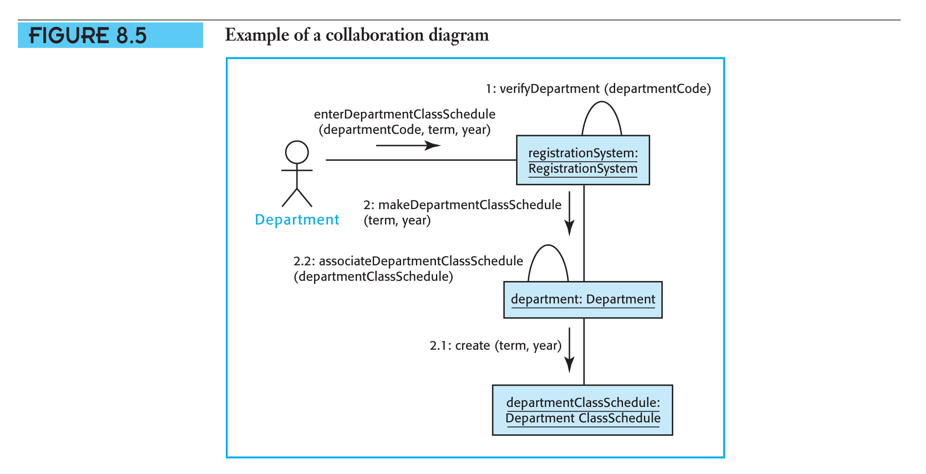
Collaboration Diagrams (continued)
.

Slide 100
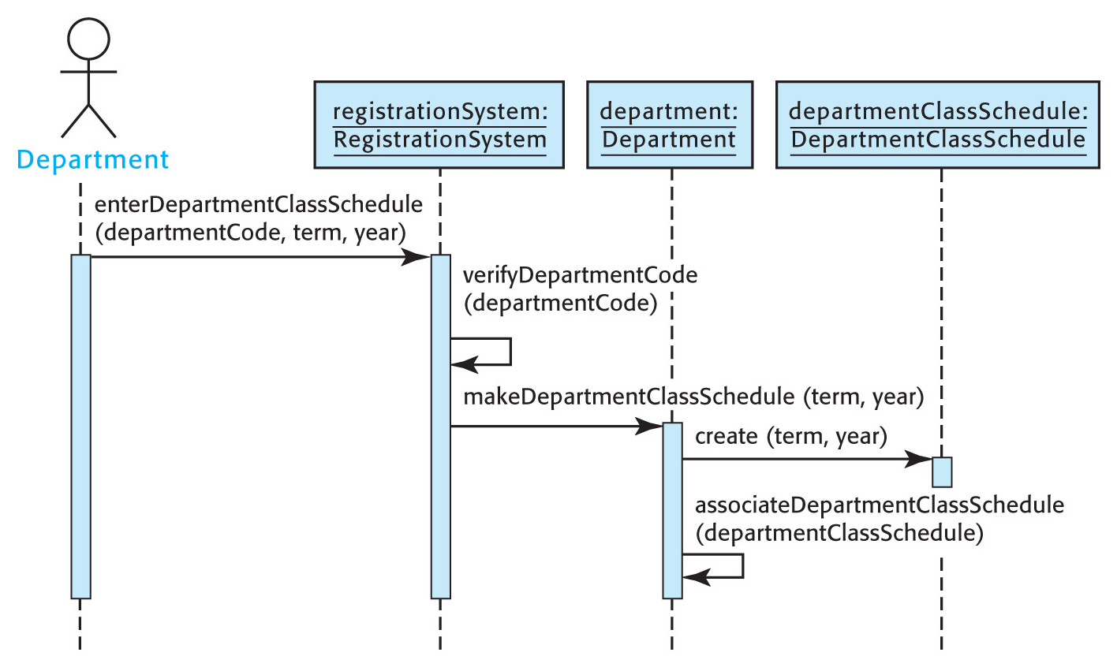
Sequence Diagrams (continued)
.

